Slide 1
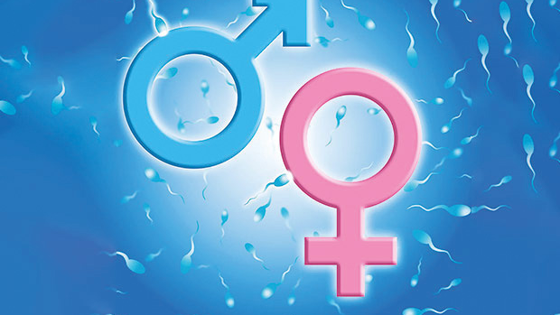
SEX DETERMINATION
Mary Kay

Slide 2
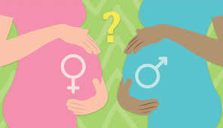
What Is Sex Determination?
Sex determination is a process of development by which the sex of an individual is settled. Sex is a method of reproduction which is widespread among living things. It requires two individuals of the same species.

